Slide 1
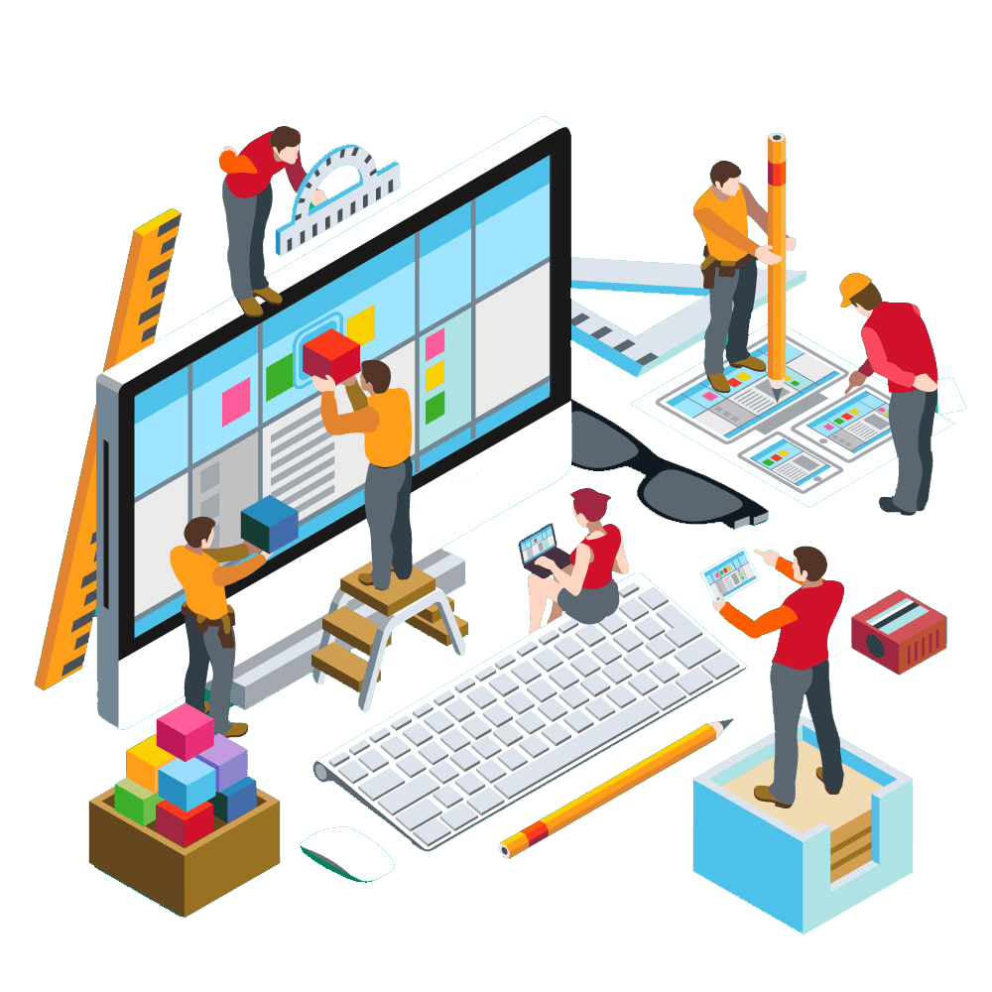
Agile Software Engineering
Testing, Quality and Integration

Slide 2
Quality
The Agile Manifesto principle “Continuous attention to technical excellence and good design enhances agility” emphasizes that quality is a central theme for Agile development.
In this chapter, we discuss how quality can be maintained and even enhanced using Agile tools.
Sprints are short and do not offer extensive time for testing; therefore, incorporating testing and various testing tools is of critical importance.
One of the key tenets of Agile is “frequent verification and validation” of working software, focusing on different testing approaches, such as test-driven development, acceptance test-driven development, integrated testing, regression testing, and unit testing.

Slide 3
Creating a Quality-Focused Culture
Creating a culture that is relentlessly focused on quality requires a lot more than just writing a quality plan and tracking to that plan, as has been the norm with organizations using a Waterfall approach.
Quality needs to be at the basis of the organization’s culture.
The most fundamental difference between Waterfall and Agile methodologies is that Waterfall takes a more reactionary approach, whereas Agile emphasizes that teams must be proactive about quality.

Slide 4
Creating a Quality-Focused Culture
For example, in many Waterfall projects, code from the various supporting areas such as the user interface and the back-end database may not be integrated until the development work is completed.
Each individual area may have done unit testing on their specific code, but they have no sense of how well that code will work with the other code that is needed to make a working product.
By the time it finally comes together in Waterfall, the code is no longer fresh in the minds of the developers and can often take longer to fix.
The team of developers might also be suddenly overwhelmed with a huge backlog of defects that need to be fixed.

Slide 5
Creating a Quality-Focused Culture
Agile, on the other hand, advocates for daily builds that integrate all of the current code for the product.
If the build breaks, the team is immediately alerted and the developers can resolve the problem quickly, because the details of the code are fresh in their minds and there is a lot less new code to work through.
This keeps defects backlogs at a much more manageable level for the team.
Agile teams also use specific tools such as pair programming, test-driven development, and refactoring to continually manage product quality.

Slide 6
Pair Programming
Pair programming, an idea that was introduced by the XP methodology, consists of two programmers sitting side by side with a shared workstation.
Each person in the pair is either the driver, the one writing the code, or the observer, who oversees the code as it is being written.
Typically these roles are switched regularly during a pairing session.
The driver is tasked with inputting quality working code while the observer thinks of ideas on how to optimize the code and points out any problems that arise.

Slide 7
Pair Programming
Pair programming, an idea that was introduced by the XP methodology, consists of two programmers sitting side by side with a shared workstation.
Each person in the pair is either the driver, the one writing the code, or the observer, who oversees the code as it is being written.
Typically, these roles are switched regularly during a pairing session.
The driver is tasked with inputting quality working code while the observer thinks of ideas on how to optimize the code and points out any problems that arise.

Slide 8
Pair Programming
Developers are encouraged to pair with a variety of different people on the team for optimal learning and to familiarize themselves with all areas of the code.
Testers and other functional areas can also benefit from participating in pair programming.
Pair programming offers several important benefits that contribute to the quality of the product.
The first is that both programmers are learning from each other and becoming more familiar with different aspects of the product.
This is important for continual improvement and cross-training, but also helps expedite code defects as they arise during the build.

Slide 9
Pair Programming
The second benefit is that pair programming allows each developer to focus on his or her specific role; there is a lot less cognitive overload when a developer can concentrate on getting the code working while letting the pairing partner focus on things such as performance optimization or possible bugs.
Finally, pairing can also build trust and encourage more regular communication between team members.

Slide 10
Test-Driven Development (Unit Testing)
Test-driven development (TDD) originated with XP and has become a widely adopted approach for developers to test their code.
Unlike traditional Waterfall approaches, where the developers first write the code and test it afterward,
TDD requires that developers first write automated test cases and then write only the code necessary to make the test cases pass with no issues.
This encourages the developers to think through the requirements before writing the code, encourages only the code that is needed is written, and ensures that each piece of the code has gone through an initial quality check before formal testing.

Slide 11
Test-Driven Development (Unit Testing)
So how do you write a test for each individual piece of code that you intend to write?
1. Decide what language the code will be written in, and then ensure that you have the correct testing framework to use with that language.
  For example, if you are coding in Java, then you would use JUnit.
2. Start by writing a test for the simplest case that can be used for the method.
  If you run this test, it should fail because you have not written the code to make it pass.
3. Write the least amount of code possible to make the test pass.
4. If it passes, you can move on to the next test case for that method (or the next method if that one is complete).
If it does not pass, you need to modify the code until the test passes.

Slide 12
Refactored Code
Defines refactoring as “the process of changing a software system in such a way that it does not alter the external behavior of the code yet improves its internal structure”.
Refactoring does not mean you are debugging your code, but rather cleaning it up so that extraneous code is removed and it complies with other patterns or structures that may exist in the product.
Refactoring is a process to ensure that the least amount of code is written to pass a failing test.
The idea of refactoring originated from the mathematical term equivalence, where equations are continually reduced until no additional reductions can be made.

Slide 13
Refactored Code
The same is true with code:
You are not ultimately changing the functions, but you are reducing them to the simplest form possible that keeps the code functioning as it was intended.
Steve Wozniak, cofounder of Apple, used the idea of refactoring when they were creating the first Apple computer.
He started with x number of parts, say 25, then he tried to build the same computer with 20 parts, then 15, and so on.
He kept reducing the number until he was certain that he had the minimum parts, hence the fewest potential break points.

Slide 14
Refactored Code
Remove Dead Code
Removing unused methods, variables, or unreachable code to clean up the codebase.
Before: (Java)
  public void calculate() {
  int x = 10; // Unused variable
  System.out.println("Hello");
  return;
  System.out.println("World"); // Unreachable code
  }
After:
  public void calculate() {
  System.out.println("Hello");
  }

Slide 15
Refactored Code
Simplify Conditional Logic
Consolidating fragmented or repetitive conditional expressions to make them easier to follow.
Before: (Javascript)
  if (user.age < 18) return "Minor";
  if (user.hasParentalConsent) return "Minor";
  return "Adult";
After:
  if (isChild(user)) return "Minor";
  return "Adult";
  function isChild(user) {
  return user.age < 18 && !user.hasParentalConsent;
  }

Slide 16
Minimizing Defect Backlog
The best-case scenario when creating a product is to carefully write the code so that defects are never introduced.
Although most developers would prefer to spend all of their time writing new and innovative code, to err is human, and defects happen in even the most thoughtfully developed products.
To create a quality product, there has to be a continuous focus on defect detection during all phases of development, from finding a bug while pairing to running regular integration tests.

Slide 17
Minimizing Defect Backlog
The longer you wait to fix a bug, the more the organization will ultimately pay in time and money.
Developers can usually find and fix bugs much faster if the code is fresh in their minds.
If it has been months since a developer looked at a section of the code, then it is highly likely that another team member has modified that code, making it more difficult to fix.
If a bug is found in the field, you risk a hit to product reputation and the loss of valuable customers.

Slide 18
Minimizing Defect Backlog
“Working software is the primary measure of progress,” Agile promotes continual integration builds.
This means that as soon as the code is checked in, it is integrated with the overall product build.
This does not mean the updates are part of the live product; it simply means that a new integrated build is always available to the product development team for testing.

Slide 19
Minimizing Defect Backlog
Some Agile teams are so focused on finding defects quickly that they have implemented a system where a siren or alarm goes off when new code breaks a build; the siren alerts the entire team that there is a problem and allows them to respond immediately.
Developers do not want their code to be the one that causes the embarrassing noise, so they are motivated to carefully test before they check anything in for a build.

Slide 20
Manual, Automated, and Customer Testing
A product development team has two options when testing whether the code is working as it was designed.
Manual Testing
The first is manual testing, where a human tester must progress through each step or look over the product to make sure nothing about the code or design is defective.
Manual testing can be very time-consuming and is subject to human error, but is often necessary in cases where the feature cannot be automated or if it is a visual update such as a background color that must match the rest of the product.
Manual testing is often used when validation of the user interface is required.

Slide 21
Manual, Automated, and Customer Testing
Automated Testing
The other option is automated testing, which uses software that is independent of the software being tested to execute tests without human intervention and compare the results against the desired outcome.
A single test or a string of tests can be automated, but running a series of tests tends to provide the most benefit.
An automated test can be anything such as a series of clicks in a user interface, executing commands in a command-line interface, or checking that data is appropriately stored in a database.

Slide 22
Manual, Automated, and Customer Testing
Customer Feedback
Customer feedback can take many forms.
Alpha tests are used to allow customers to try early versions of the code.
Beta tests are similar in that they allow customers to try out the product before it is released generally to the public, but the product has been through much more extensive testing by the development team.
Usability testing involves observing the customer interacting with the product to understand where there may be opportunities to improve the ease of use.

